Slide 1
Computer Systems, Data Structures & Data Management
Markos Vassilis
Mediterranean College
Week 14

Slide 2
A Quick Catch-up first…

Slide 3
What we saw last time… 1 / n
What is the main reason for using a DB?
Data are inherently unstructured, so DBs are used to impose structure and organization on them, to facilitate further processing (searching, splitting, sorting etc).
What are some problems that arose with the use of system files for storing data back in the 60s?
Some of the most significant problems include: data inconsistency, redundancy, difficulty of access, data isolation, integrity and atomicity problems, concurrent access anomalies and security issues.

Slide 4
What we saw last time… 2 / n
Briefly describe the three levels of DB abstraction:
The three levels of DB abstraction are:
  Physical level: Data as stored at the lowest level (e.g., the primitive data structures used for that purpose).
  Logical level: Data as organised through higher-level constructs (e.g., teacher, course, student of the XYZ University).
  View level: Data or portions of them as distributed to non-expert end users.

Slide 5
What we saw last time… 3 / n
What is a DB instance and what a DB schema? What is their main difference?
DB schemas refer to the design of a database which remains, in general, intact throughout the course of time. On the contrary, DB instances refer to “snapshots” of a DB at a specific moment in time and, in general, are subject to change as data are altered, added or removed from a DB.
What levels of abstraction apply to DB schemas?
The same that apply to DBs, i.e., there are physical schemas, referring to the lowest level organisation of a DB, logical schemas, referring to higher level organisation, and subschemas, referring to how the various DB views are organised.

Slide 6
What we saw last time… 4 / n
What is a data model?
A data model is a collection of conceptual tools for describing data, data relationships, data semantics, and consistency constraints.
What are the four main data model categories?
The main data model categories include:
Relational models, which represent data through tables of similar records;
E-R models, which represent data through entities interrelated through relationships;
Object-based models, which borrow concepts from OOP, and;
Semi-structured models, allowing for more relaxed data representation.

Slide 7
What we saw last time… 5 / n
Right or Wrong? A DB language can be both a data-description and a data-manipulation language.
Right. Most modern languages include functionalities that support both data manipulation as well as their description.
What types of Consistency Constraints are implemented by DDL?
Four types of constraints, including:
Domain constraints;
Referential integrity;
Assertions, and;
Authorization.

Slide 8
What we saw last time… 6 / n
What are the two main categories of DML?
The two main categories of DML are:
Procedural languages, which require the user to specify what data they want to access and how to do so, and;
Declarative (nonprocedural) languages, which require users to specify only what data they want to access, without specifying how.

Slide 9
Database Design

Slide 10
The XYZ University
In our previous lecture we discussed the case of the XYZ University. Think of it for a moment…
Now, open: https://dbdiagram.io/d
Try to design a simple databases including three (or more) tables regarding the case of the XYZ University - the tables you will include need not be the same as last time.
Don’t forget to add relationships between your tables!
DBML Docs: https://dbml.dbdiagram.io/docs/
Don’t close the browser tab you are working on, we will use it throughout the lecture.

Slide 11
Database Design Process 1 / n
Specify data needs (this is done with the assistance of domain experts).
Conceptual-design phase: Translation of the requirements to a specific data model.
Logical-Design phase: Translation of the data model to the specific DB system that will be used.
Physical-Design phase: Discussion and selection of the actual data structures, file systems and algorithms that will be used.
No matter what, we need to avoid redundancy, i.e., repeating information, and incompleteness, i.e., missing information. Each DB should be minimally complete!

Slide 12
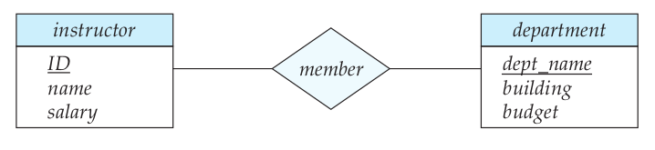
(Reminder) The E-R Model 1 / n
Entity set: The set of all entities, i.e., of all “things” in our application scenario.
Relationship set: The set of all relationships among entities, e.g., an instructor of the XYZ University is a member of one of its departments.
Unified Modeling Language (UML) is a common way to represent E-R models:
Relationship
Entities

Slide 13
(Reminder) The E-R Model 2 / n
Entities are described by attributes.
Attributes have values.
Attributes also have domains, i.e., sets of permitted values they can take:
  single-valued attributes, which admit one value at a time;
  multivalued attributes, which admit potentially many values at a time (e.g., one’s phone numbers).
  derived attributes, which are determined by other entities (e.g., attending students, which represents the number of students in a certain course).
Attributes can be simple or composite (comprising of other attributes).
“Single” and “multi” in the above refer to a specific instance of an entity and not the entity in its entirety.

Slide 14
Cardinalities 1 / n
Cardinality (in data models): The number of entities to which another entity can be associated through a relationship set:
  one-to-one;
  one-to-many;
  many-to-many.
For instance, a department has many instructors, so this is a one (department) to many (instructors) relationship.
If each instructor should be member of a single department, then this is a one-to-one relationship.

Slide 15
Cardinalities 2 / n
What is the cardinality of the following relationships?
Instructor and Department?
Student and Department?
Instructor and Advisor?
Student and Advisor?
Department and XYZ University?

Slide 16
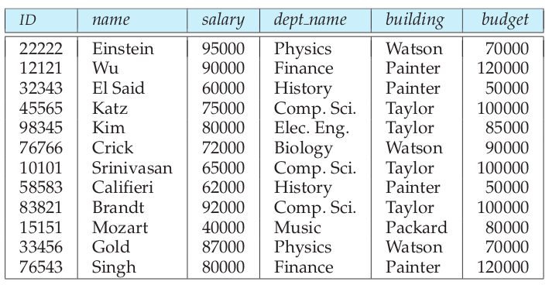
The XYZ “Faculty” Table - Do you see any issues?

Slide 17
Data Normalisation
To avoid cases where we:
  have data repetition;
  cannot represent certain information;
  …
…we use data normalisation, i.e., impose certain normal forms to our DB schemata.
What could we do better for XYZ?
  Use separate tables for instructors and departments?
  Use nulls for missing information?
Null: Special value indicating that a certain piece of data is missing. Better to be avoided.

Slide 18
Back to the XYZ University
Having all this knowledge, how would you restructure your database? (see the tab you have left open on your browser)
Extend you DB to cover a more complex setting than what it currently covers - add tables and / or relationships between / among them and existing ones.

Slide 19
What we saw today… 1 / n
Which are the key steps in DB design?
There are four key steps:
Data-needs specification;
Conceptual-design phase;
Logical-design phase;
Physical-design phase.
Which are the two main sources of problems we avoid when we carefully design our DB?
Redundancy (i.e., information repetition) and incompleteness (i.e., missing information).

Slide 20
What we saw today… 2 / n
What types of attributes are there, with respect to values count?
There are:
single-valued attributes;
multivalued attributes;
derived attributes.
Right or Wrong? A single-valued attribute takes a single value for all instances of an entity.
Wrong. It takes a single value for each instance, potentially a different one.

Slide 21
What we saw today… 3 / n
What is “cardinality” in data modelling?
The number of entities to which another entity can be associated through a relationship set:
one-to-one;
  one-to-many;
  many-to-many.
Name two benefits of data normalisation.
Through data normalisation one avoids repetition of data as well as cases where some specific information cannot be represented in the DB.

Slide 22
Fun Time!

Slide 23
Some Guidelines by MS 1 / n
Organizing data: Once you have an idea of the data you would like to collect, you need to decide how many tables you might want to use to organize the data efficiently. In Excel, we might keep several numbered columns to keep track of things, i.e. Medication1, Medication 2…, but in Access we should create a second table to track the numbered fields.
No Derived Fields: By using the relationships between our datasets, we can derive missing data. If we are creating a new appointment for a patient, we only need to put in their Medical Record Number (or other unique identifier). The patient's name, phone number, and other information can be derived from the Patient Table.

Slide 24
Some Guidelines by MS 2 / n
Data is broken down into Smallest Logical Parts: Pulling fields together in Access is often simple; pulling them apart usually requires human intervention. Think of this as breaking up the data into its smallest sort‐able part.
Descriptive Field Names: It's tempting to use abbreviations when we are creating our data tables, but if the title we use is too vague or too abbreviated we may not be able to recall why we created that field. DOB – Date of Birth or Department of Babies? SSN – Social Security Number or Shands System Number?

Slide 25
Some Guidelines by MS 3 / n
Unique Field Names: Be sure to differentiate between the field names in each Table. We can have a 'First Name' in our Patient Table and a 'First Name' in our Doctor Table but this can lead to confusion when we try to pull both Tables into one database object.
No Calculated Fields: In Microsoft Excel, we can perform our calculations on the same sheet as our data, but a Table in Access is stagnant data, it does not change unless you make it change. Access will let you create calculations in Queries, Forms and Reports. Newer versions of Access do have a Calculated field type for the table. This embeds a calculation in the record and is not always reflected in a data entry form.

Slide 26
Some Guidelines by MS 4 / n
Unique Records: It's important that each Table has a way to keep records unique. We can do this by setting one field (column) to be a Primary Key field. When a field is set as a Primary Key, Access will not allow any duplication nor blanks. When there is not a unique field in your data set, you can use an AutoNumber. AutoNumbers are incremented or random fields that are always unique.

Slide 27
Lab
Open:
./labs/Lab 13 - Introduction to Databases
and follow the instructions found there.
Additional materials to help you get started can be found in:
./labs

Slide 28

Any Questions?
Don’t forget to fill-in the questionnaire! (check right)
https://forms.gle/edpsrRjMWJwPtv3U9

